Slide 1
City Paints the Picture
City of Sammamish Finances and New Taxes
Crossover 2020 or 2022

Slide 2
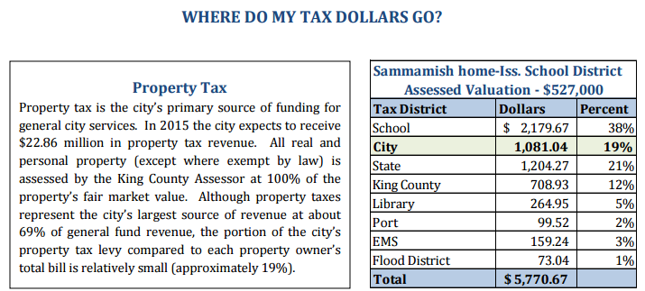

Slide 4
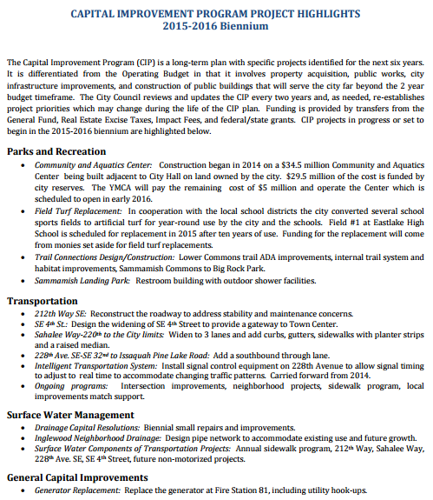

Slide 6
Planning..
What will dollar requirements be in the future? (Projects)
What are the priorities?
What will they cost?
When will the dollars be required? (start and finish)

Slide 7
Considerations..
What cutbacks/deletions make sense?
What are “real expenditure” numbers?
What save if cut General Fund Transfer Expenditures 10%, cut back to 100 FTE’s, and transfer dollars from allowable Funds to General Fund?

Slide 8
Additional Revenues..
Real Estate taxes..”banked”
Utility tax..(some 6% & some no top on what can charge)*
Franchise fee..(no top on what can charge)**
Bonds..$50mil @ 4% = 2mil/yr int. + principal (Councilmanic vs. Voter approval?)

Slide 9
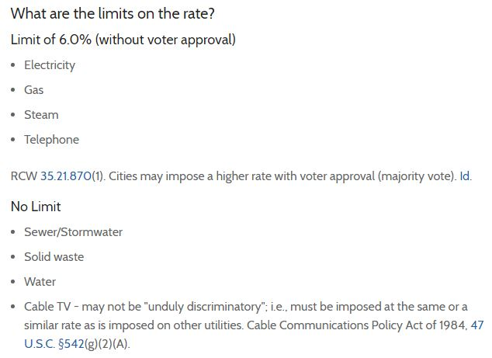
(Utility taxes)*

Slide 10
Municipal Franchise Fees**
In general, a municipal franchise fee is the “rent” that a utility company pays the city to use the right-of-ways (ROW) for its lines, pipes, poles, etc. While the utility company collects this fee, it is turned over to the city, which uses it as a revenue stream.
It is a cost to the consumer which goes to the city. It is regressive, and basically with the same result of a tax.

Slide 11
